Slide 1
Project Timeline
Presentation
By: Michael Calle & Eric Liu

Slide 2



The Problem
Dynamic Danger
Limited Capacity
Time vs Safety
Evacuating civilians is harder than it looks
Roads turn deadly mid-operation, bombed, blocked, or overrun. Static paper maps cannot adapt in real time.
Safe zones overflow. A convoy of 500 cannot all go to the same camp. Routing must account for available slots.
The fastest route is rarely the safest. Coordinators must balance urgency with danger exposure, a human trade-off encoded in math.

Slide 3
System Overview
Dijkstra's Algorithm
Layered Architecture
Models a road network as a weighted directed graph
Computes optimal evacuation routes via Dijkstra's algorithm
Checks reachability of all safe zones using BFS
Handles capacity limits: redirects when zones fill up
Supports 3 mobility types with different speed penalties
Adapts dynamically to road closures and danger updates
Web UI / CLI
EvacuationPlanner
algorithms.py
EvacuationGraph
Models + Constants
dependency flow ↑

Slide 4
Deliverables
Node Types
Edge (Road) Attributes
CIVILIAN: Source locations, villages, and towns
distance_km
Physical length
SAFE_ZONE: Destinations with capacity limits
base_speed_kmh
Road speed limit
CHECKPOINT: Intermediate routing nodes
status
CLEAR / DAMAGED / BLOCKED
MEDICAL: Field stations for injured routing
danger_score
0.0 – 10.0 risk rating
bidirectional
Two-way by default

Slide 5
Core Algorithms
Dijkstra's Algorithm
Dijkstra's Algorithm
Purpose: Finds minimum composite-cost path to a safe zone
How: Min-heap priority queue. Each pop relaxes neighbours. Skips BLOCKED roads and danger > threshold.
Complexity: O((V + E) log V)
Returns: route · distance · time · max danger · avg danger · composite cost · warnings
Variants: dijkstra() | dijkstra_all_safe_zones()
Purpose: Structural reachability — which safe zones can we reach at all?
How: Queue-based level-order traversal. Ignores cost, only follows active edges.
Complexity: O(V + E)
Returns: reachable node set · reachable safe zones · cut-off safe zones · hop counts
Variants: bfs_reachability() | bfs_nearest_safe_zone()

Slide 6
4-Tier Cascading Fallback Strategy
BFS Reachability Check
Dijkstra: Safety Constrained
Dijkstra: Danger Relaxed
BFS Nearest Zone Fallback
Run BFS from source.
If zero safe zones are reachable, abort immediately with a CRITICAL alert.
No route can be planned in a fully surrounded location.
Run Dijkstra excluding roads with danger > 7.0.
If target is at capacity, try all safe zones sorted by cost and pick the first available.
If no safe route exists, remove the danger threshold and retry.
Route is returned with a warning: 'Danger threshold relaxed, elevated risk.'
If all Dijkstra attempts fail, report the BFS-nearest safe zone by hop count.
Manual assessment required, no costed path available.

Slide 7
Important lessons from similar projects
x1
Key learning
Vehicle convoys: no speed penalty. Fastest evacuation option. Best for large groups on intact roads. Ex. 13 min
x3.5
ON_FOOT
Civilian pedestrians: speed divided by 3.5. Same 12 km route takes 36 min vs 13 min by vehicle. Ex. 36 min
x8
INJURED
Stretcher or assisted movement: speed divided by 8.0. Mass evacuation planner prioritises this group first. Ex. 82 min

Slide 8
Sample Scenario Execution Results
Scene 1
Scene 2
Scene 3
Scene 4
Vehicle · 80 pax
VILLAGE_A -> CAMP_NORTH → UN_COMPOUND
13.0 km · 13 min · Danger: 1.0 / 10
✓ Accepted: 80/80
On Foot · 200 pax
TOWN_CENTER → UN_COMPOUND
12.0 km · 36 min · Danger: 3.0 / 10
✓ Accepted: 200/200
BFS Reachability
From VILLAGE_B, max 6 hops
8 / 8 nodes
✓ 3/3 safe zones reachable
Road Bombed
VILLAGE_A → CAMP_NORTH → UN_COMPOUND
13.0 km · 13 min · Danger: 1.0 / 10
✓ Re-routed automatically

Slide 9
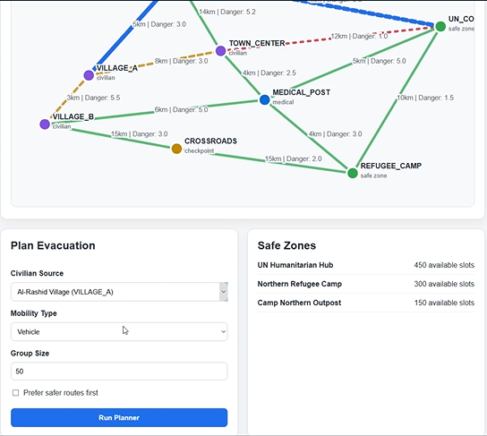
Flask Web Interface
Web App Capabilities
Form-based source + mobility + group size input
prefer_safety toggle for risk threshold control
Displays route, distance, time, danger metrics
Shows warnings for damaged roads or relaxed danger
Reports BFS reachability alongside Dijkstra route
Built with Flask — lightweight, no JS frameworks

Slide 10
Conclusion
The Graph represents the road network, while the nodes are locations, and edges are roads with composite cost
The Dijkstra finds the optimal route. While BFS confirms reachability and provides fallback guidance.
With the 4-tier fallback, the system never fails silently — it degrades gracefully through four strategies before reporting a manual assessment need.
Real Constraints, such as road destruction, safe zone capacity, mobility type, and danger thresholds are modelled

